Slide 1
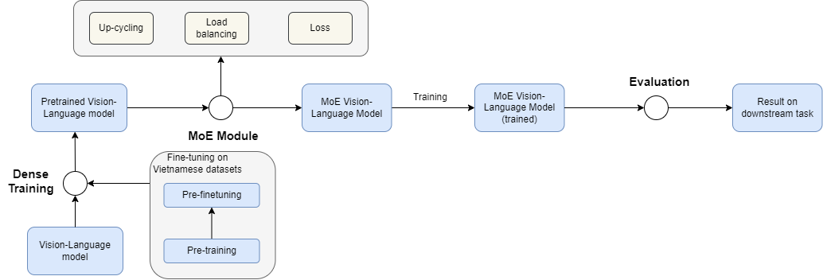
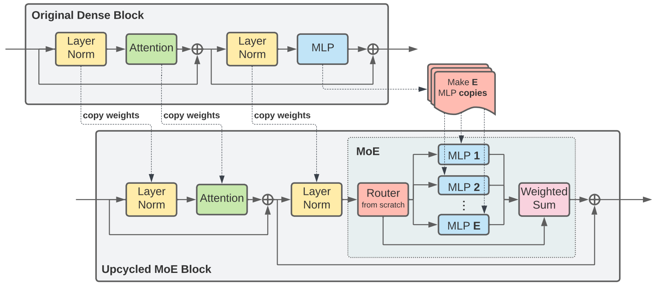
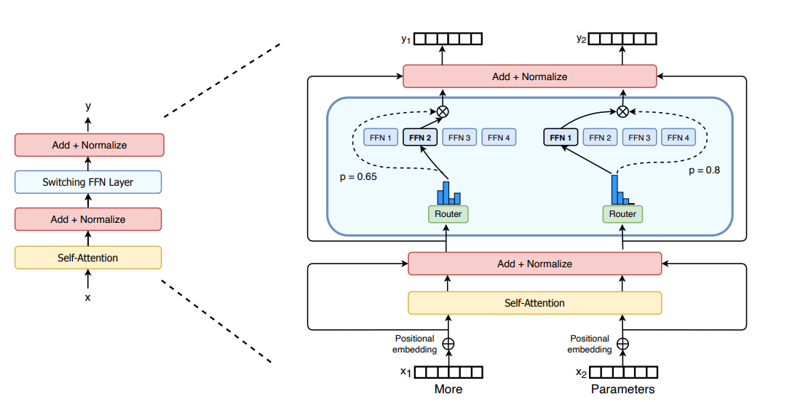
MIXTURE OF EXPERTS FOR VIETNAMESE MULTIMODAL LEARNING
Nguyễn Hoàng Quý
University of Information Technology
HCMC, Vietnam
What ?
Why ?
Propose a novel Mixture of Experts (MoE) architecture for small-scale Vietnamese vision-language models.
Build a synthetic multimodal dataset for Vietnamese downstream tasks.
Conduct comprehensive experiments between MoE and traditional dense architectures.
Analyze the impact of model scaling (small, base, large) on multimodal learning performance.
LLMs achieve remarkable performance thanks to abundant resources, but they are often impractical in low-resource environments like Vietnam.
Mixture of Experts offers a promising solution to reduce computational costs while maintaining high efficiency.
Developing MoE architectures for small-scale vision-language models,, is a crucial step toward expanding multimodal AI applications.
Overview
Description
1. Dataset Construction
3. Training Strategies
Collect and explore Vietnamese multimodal datasets (e.g., UIT-ViLC, ViOCRVQA, ViVQA).
Build a synthetic dataset tailored for multimodal learning tasks.
Explore up-cycling FFN (reusing pretrained models and duplicating experts).
Implement load balancing and expert specialization to distribute knowledge effectively.
Apply multimodal and MoE-specific loss functions (e.g., contrastive loss, sigclip loss, z-loss, importance loss).
2. Model Design
Figure 2. Example of Up-cycling training.
Develop a Mixture of Experts (MoE)-based architecture to align text-image features.
Experiment with cross-modal and inter-modal learning using language models (BERT, RoBERTa) and vision backbones (ViT, VGG), as well as pretrained vision-language models (CLIP, SigCLIP).
4. Evaluation & Analysis
Conduct experiments to assess the effect of varying expert numbers, loss functions, and backbone models.
Compare MoE vs. dense architectures on downstream tasks (image captioning, VQA) and analyze scaling impacts (small, base, large).
Figure 1. Example of Mixture of Expert Block.
Nguyễn Hoàng Quý – Trường Đại học Công Nghệ Thông Tin
TEL : 0974729224 Email : quynh.19@grad.uit.edu.vn
Notes:
‹#›

